Slide 1


MUTUAL FUND DATA ANALYSIS AI
PRESENTED BY:
HARI HARAN. A

Slide 2

Proposed Solution
Objective:
Our primary objective is to develop a robust and user-friendly web application tailored for mutual fund data analysis. This application aims to empower users, including investors, financial analysts, and researchers, to gain valuable insights from their mutual fund datasets effortlessly.
Solution:
We propose the development of a web application using Streamlit, a Python framework for building interactive web applications. The application will allow users to upload CSV files containing mutual fund data directly through the user interface. Upon upload, the application will perform comprehensive data analysis, including calculating geometric and arithmetic means, visualizing trends, and providing AI-driven insights. Leveraging powerful Python libraries such as Pandas, NumPy, and Plotly Express, along with the OpenAI API for advanced analysis, our solution ensures accuracy, efficiency, and user engagement.

Slide 3
Proposed Solution (contd.)
Key Features:
Data Upload:
Users can easily upload multiple CSV files containing mutual fund data through a simple and intuitive interface.
Analysis:
The application will conduct thorough statistical analysis, including calculating geometric and arithmetic means, identifying trends, and detecting outliers.
Visualization:
Various visualization options will be available, such as line charts, donut charts, and bar charts, enabling users to visualize data patterns effectively.
AI Insights:
Integration with the OpenAI API will enable the generation of AI-driven insights and recommendations based on user prompts, enhancing the depth of analysis.

Slide 4

Problem Statement
Issue:
Mutual fund data analysis often poses challenges due to the complexity of financial datasets and the lack of user-friendly analytical tools. Many existing solutions require technical expertise and significant time investment, hindering accessibility and efficiency.
Challenge: Our primary challenge is to develop a solution that simplifies mutual fund data analysis while maintaining robust analytical capabilities. We aim to address the usability gap by providing an intuitive platform that caters to users with varying levels of expertise, from novice investors to seasoned financial professionals.
Objective:
By addressing these challenges, our goal is to democratize mutual fund data analysis, making it accessible and actionable for all users. We aim to empower individuals and organizations to make informed investment decisions, uncover hidden insights, and optimize portfolio performance effectively.

Slide 5

Outline
Introduction: Overview of the project and its objectives.
Data Upload: Allow users to upload CSV files containing mutual fund data.
Analysis: Calculate geometric and arithmetic means, display visualizations.
AI Insights: Generate insights using OpenAI API based on user prompts.
User Interface: Intuitive interface for seamless interaction and exploration.
Conclusion: Summary of findings and future directions.

Slide 6

Algorithm & Deployment
Data Processing:
Provide insights into the algorithms and methodologies used for data processing, including data cleaning, normalization, and statistical calculations.
Visualization:
Discuss the algorithms behind data visualization techniques, such as plotting trends, identifying patterns, and customizing chart properties for effective communication of insights.
AI Integration:
Detail the deployment and integration of the OpenAI API for natural language processing, including model selection, input-output mapping, and response handling.
Deployment:
Explain the deployment process of the web application using Streamlit, covering server configuration, scalability considerations, and user access management.

Slide 7
System Approach
Frontend:
Elaborate on the frontend development approach, focusing on user interface design principles, component architecture, and responsive layout implementation.
Backend: Describe the backend architecture, emphasizing data processing workflows, API integrations, and server-side logic for efficient data handling and analysis.
AI Integration:
Discuss the integration of AI capabilities into the system, including model training, inference pipeline setup, and result interpretation for seamless user interaction.
Scalability:
Address scalability considerations, such as database optimization, resource allocation, and load balancing strategies, to ensure the system can accommodate growing user demands effectively.

Slide 8

Reference
Streamlit Documentation: https://docs.streamlit.io/
Pandas Documentation: https://pandas.pydata.org/docs/
NumPy Documentation: https://numpy.org/doc/stable/
Plotly Express Documentation: https://plotly.com/python/plotly-express/
OpenAI API Documentation: https://beta.openai.com/docs/

Slide 9
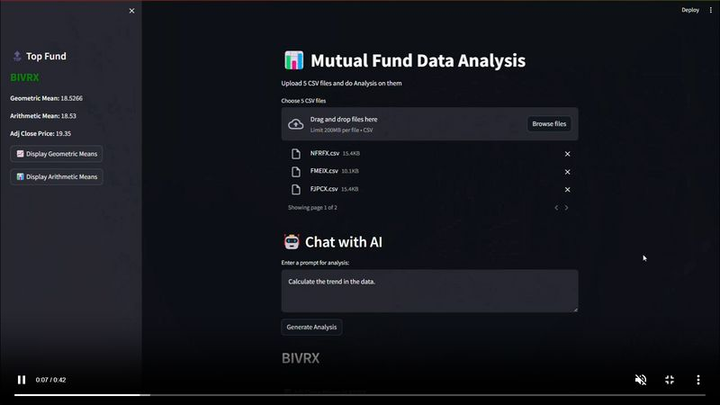
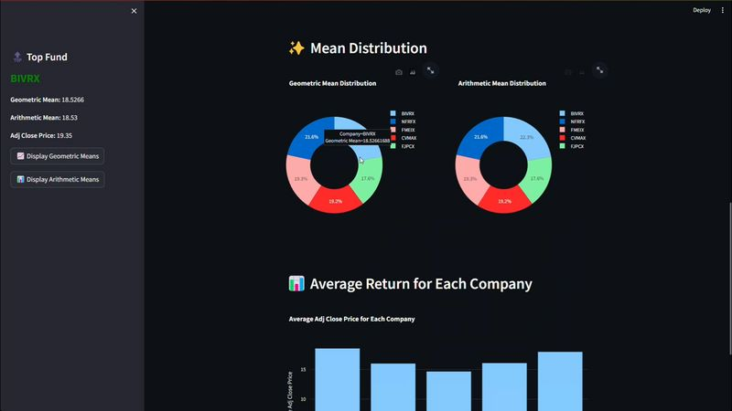
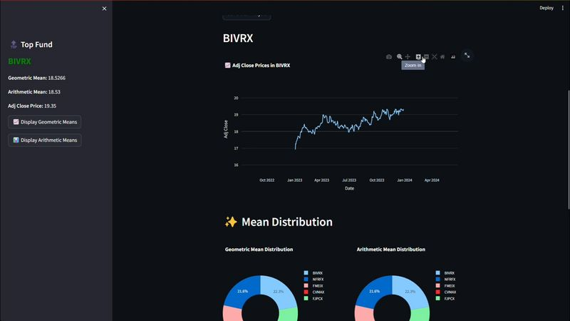
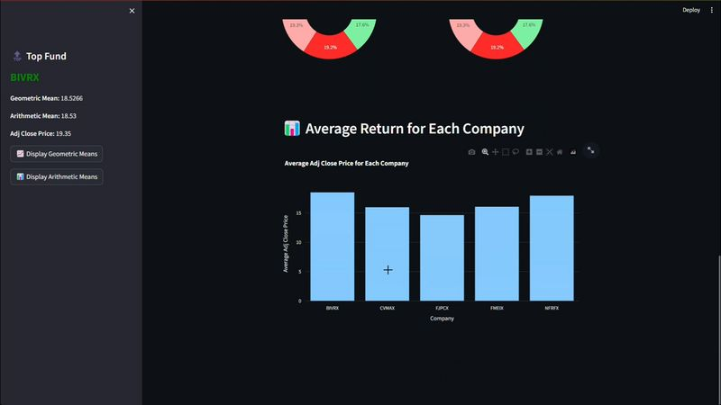
Result

Slide 10

Conclusion
Achievements:
Reflect on the accomplishments of the project, including the development of a user-friendly mutual fund data analysis platform, integration of advanced analytical techniques, and successful deployment.
Future Directions:
Outline potential areas for future development and improvement, such as enhancing AI capabilities, adding new features, expanding dataset compatibility, and incorporating user feedback for continuous refinement.

